Slide 1
Findings from SEACRIFOG Stakeholders Consultation Workshops
Acosta M, Krkoška Lorencová E, Grieco E, Bombelli A, Beck J, Salmon E, Helmschrot J, Sylla M.B, Pavelka M, Váčkárů D, Mensah C and Veronika Jorch

Slide 2
SEACRIFOG - Supporting EU-African Cooperation on Research Infrastructure for Food Security and Greenhouse Gas Observations
Financed under H2020 by the European Commission
Grant amount 1,999,890 €
16 Partner Institutions (6 in Africa, 10 in Europe)
Duration March 2017 until February 2020
The team at the annual meeting, Mindelo/Cape Verde, June 2018 © Arne Körtzinger
Countries SEACRIFOG partners are based (Cape Verde is missing)
Consortium countries of SEACRIFOG partners or home of third linked party

Slide 3
SEACRIFOG – What we do

Slide 4
General user needs and knowledge gaps (WP1)
CLIMATE SMART AGRICULTURE
Needs and gaps in terms of
-DATA
-KNOWLEDGE
-INFRASTRUCTURES
-CAPACITIES
GHG OBSERVATIONS
CARBON STOCKS CLIMATE CHANGE MITIGATION
LAND USE CHANGE IMPLICATIONS ON FOOD SECURITY
CAPACITY DEVELOPMENT

Slide 5
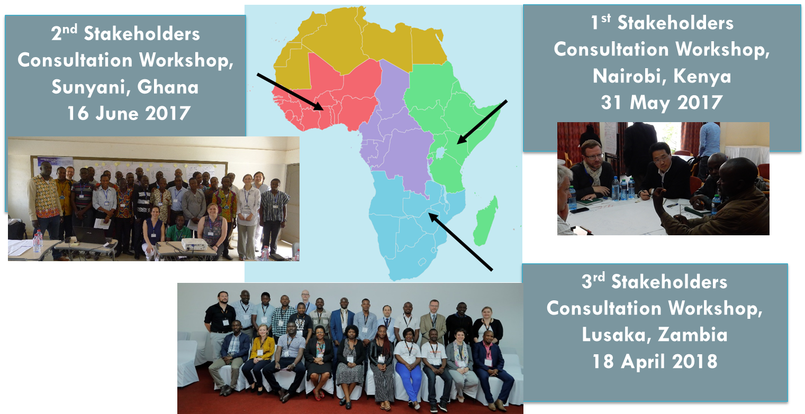
Users and Stakeholders Engagement:3 Regional Stakeholder Consultation Workshops
Notes:
4th Workshop – Special focus on Data and different format in Capetown

Slide 6
SEACRIFOG – Stakeholder Consultation Workshops
The aim of the workshops was to identify general user needs and knowledge gaps in the area of research infrastructure related to
Land use change (LUC), implication on food security.
Climate-smart agriculture
Capacity development.
Greenhouse gases (GHGs) observations, carbon stocks and climate change.
The target audience were key stakeholders connected to these areas in Eastern, Western and Southern Africa. The workshops had a format of participative workshop in a world-café mode.

Slide 7
SEACRIFOG – Stakeholder Consulatation Workshops
The World Café is a structured conversational process intended to facilitate discussion, initially in small groups and then linking ideas within a larger group to access the collective intelligence or collective wisdom in the room (Brown and Isaacs, 2005).
Stakeholder Consultation Workshop in Zambia April 2018 ©Mesach Shikabeta
Notes:
Organisers of a World Café formulate questions before an event, related to specific goals, which are discussed by participants as they move between a series of tables.

Slide 8
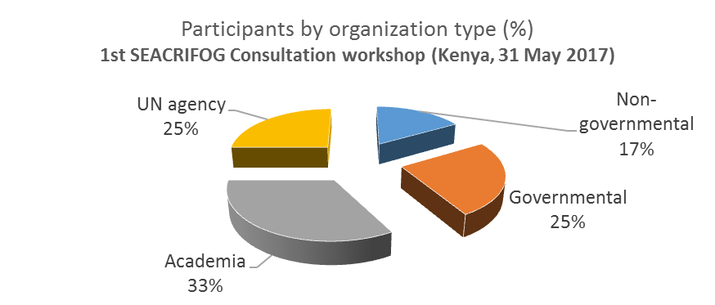
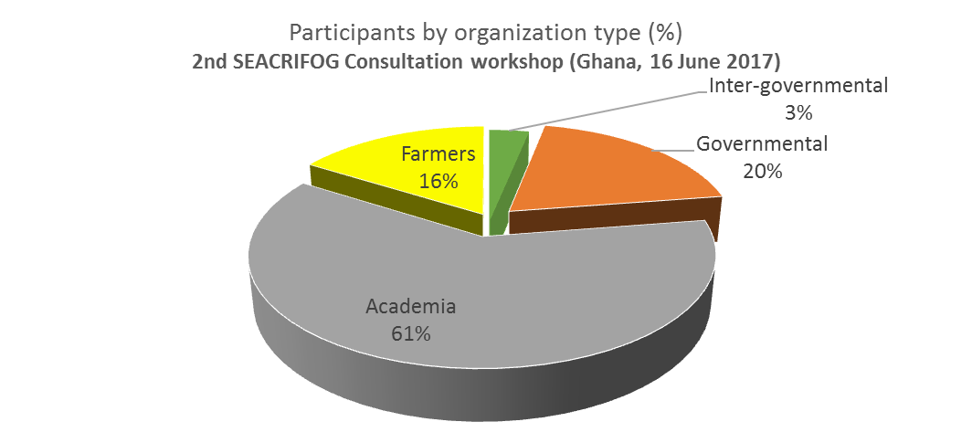
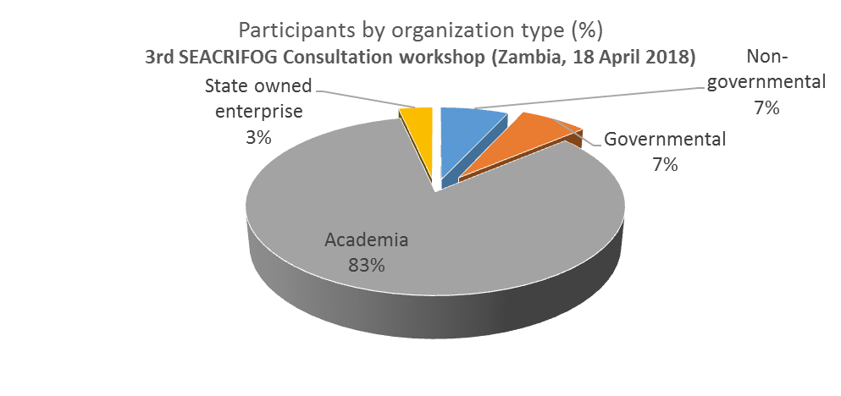
Findings from SEACRIFOG Stakeholders Consultation Workshops
In total, 73 participants from 33 organizations attended the three stakeholder’s workshops.

Slide 9
Findings from SEACRIFOG Stakeholders Consultation Workshops: DATA
LAND USE CHANGE IMPLICATIONS ON FOOD SECURITY
COMMON ASPECTS
AVAILABILITY
ACCESS
ACCURACY
INTEROPERABILITY
SPATIAL COVERAGE
TEMPORAL FRAME - USEFUL FOR THE SPECIFIC PURPOSES
CLIMATE SMART AGRICULTURE
CAPACITY DEVELOPMENT
GHG OBSERVATIONS
CARBON STOCKS CLIMATE CHANGE MITIGATION

Slide 10
Findings from SEACRIFOG Stakeholders Consultation Workshops: KNOWLEDGE and CAPACITIES
LAND USE CHANGE IMPLICATIONS ON FOOD SECURITY
Lack of EFFECTIVE
KNOWLEDGE TRANSFER
Need for a appropriate EXPLOITATION OF LOCAL AND TRADITIONAL KNOWLEDGE
Scarce and ineffective FLOW OF INFORMATION and communication both in BOTTOM-UP and TOP-DOWN directions
Lack of INVESTMENTS IN CAPACITY BUILDING and TRAINING
CLIMATE SMART AGRICULTURE
CAPACITY DEVELOPMENT
GHG OBSERVATIONS
CARBON STOCKS CLIMATE CHANGE MITIGATION

Slide 11
Findings from SEACRIFOG Stakeholders Consultation Workshops: INFRASTRUCTURES
LAND USE CHANGE IMPLICATIONS ON FOOD SECURITY
Lack of INVESTMENTS and
INADEQUATE RESOURCES
LONG TERM SUSTAINABILITY
Scarce SPATIAL COVERAGE
Need for BETTER NETWORKING
CLIMATE SMART AGRICULTURE
CAPACITY DEVELOPMENT
GHG OBSERVATIONS
CARBON STOCKS CLIMATE CHANGE MITIGATION

Slide 12
Proposed Solutions
CAPACITIES
Ad hoc trainings and educational programmes
Capacity building across various levels and stakeholders
Science-policy-end users interface
DATA
AVAILABILITY
Data repository
Long term observation systems
USABILITY
Common language/format
Not only useful data but usable data
Proper time scale and resolution
ACCESS
Improve the connection between existing RI
Open access/transnational cooperation
INFRASTRUCTURES
HIGH COSTS OF IMPLEMENTATION & MANTAINANCE
Financial investments from local governments, private sector and international institutions
Citizen science low cost monitoring infrastructure
Low cost technologies targeted for the needs on field
KNOWLEDGE
Sharing (network at different levels)
Indigenous knowledge
Connection between government and farmers through the extension offices

Slide 13
Thank you for your attention!
Veronika.jorch@thuenen.de
www.seacrifog.eu @SEACRIFOG
Thünen Institute of Climate-Smart Agriculture

