Slide 1





Designing an integrative concept
for long-term greenhouse gas (GHG) observations in Africa
Highlights of a future pan-African system
14 African countries,
7 European countries
2017–2020
Continuity is envisaged in the form of a pan-African system
Mylene NDISI¹
& the SEACRIFOG Consortium
(1) ICOS ERIC, Finland
mylene.ndisi@icos-ri.eu
RIC2019 & 4th AfriGEO Symposium
13–16 August 2019

Slide 2

Outline
  Background & Objective
  Implementation Plan & Activities
  Preliminary Results/Outputs
  Towards a sustainable system
  Expected Application Areas

Slide 3





Background
SEACRIFOG in context
Decreased crop yield, uncertain food security
Change in forest composition / land-use, climate smart agriculture
Rising population, urbanization, mass migration, extreme weather events…
Reasons for future system
The African continent currently contributes the largest uncertainty to global GHG estimates
The Paris Agreement and the 1.5/2 ºC objective call for enhanced “systematic observation of the climate system”
The IPCC Revised Guidelines for National Inventories aim at increased accuracy for emission reporting

Slide 4
Objective
Reduce uncertainties of emission estimates
through measurements over the African continent
  Identification of essential variables. Identify the variables as ideal and mandatory for GHG monitoring to support food security and climate-smart agriculture.
  Assessment of scientific and technical feasibility. Apply criteria to select the variables.
  Optimization of observation network. Optimized network of stations for uncertainty reduction through inverse models.
  Improvement of GHG emission factors. Need for locally sourced data to enhance model results (reliable baseline) and allow testing of strategies.
  Sustainability. Co-financing concept, long-term partnerships through the SEACRIFOG Dialogue Platform, capacity-building…

Slide 5
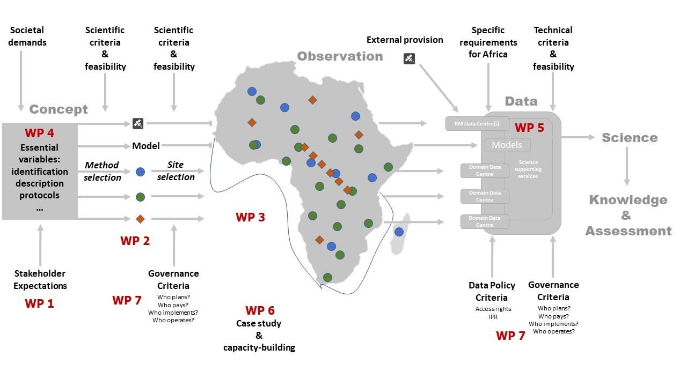
Implementation Plan / Activities

Slide 6

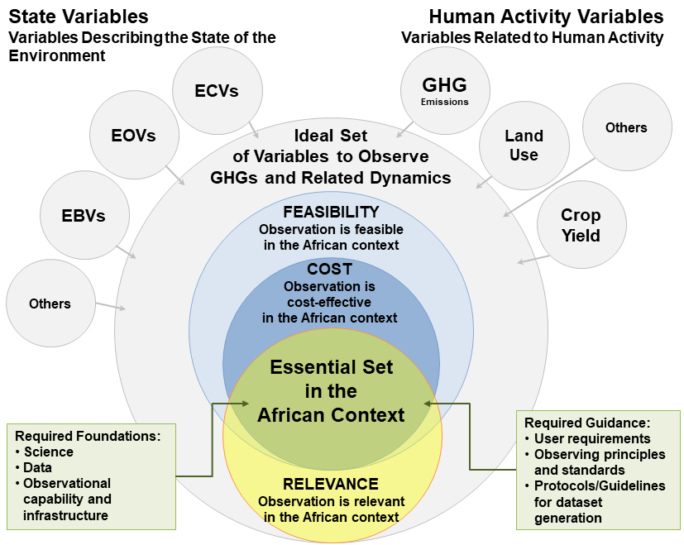
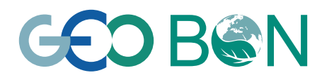
Preliminary results/outputs 1/5
1. Scientific & technical
Identification and selection of a set of variables that need to be systematically observed to capture and quantify anthropogenic climate forcing in Africa
→ 58 variables
Identification of existing stations, data and related protocols
Collaborative Inventory Tool
http://seacrifog-tool.sasscal.org
The data needed originate from remotely-sensed data, models, site-based or campaign-based in situ observations...
feasibility
Top-down
approach:
Drivers of anthropogenic climate forcing
Bottom-up
approach:
Consultation
& ranking
GOOS
López-Ballesteros et al.
https://doi.org/10.1088/1748-9326/aad66c

Slide 7
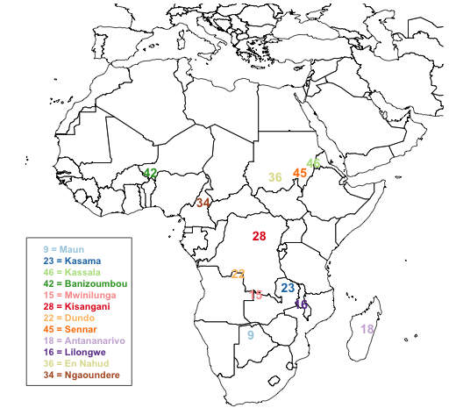
Preliminary results/outputs 2/5
2. Optimization of the observation network
Network design based on spatial and temporal optimization of new observation stations
Through inverse modelling
Aimed at reducing the overall uncertainty in emissions of CO₂, CH₄ and N₂O
→ Provide the optimal location and number of additional tall tower monitoring stations
→ Yield the highest reduction in uncertainty of GHG measurements in Africa and globally
Nickless et al. “Greenhouse gas observation network design for Africa” (in preparation)

Slide 8
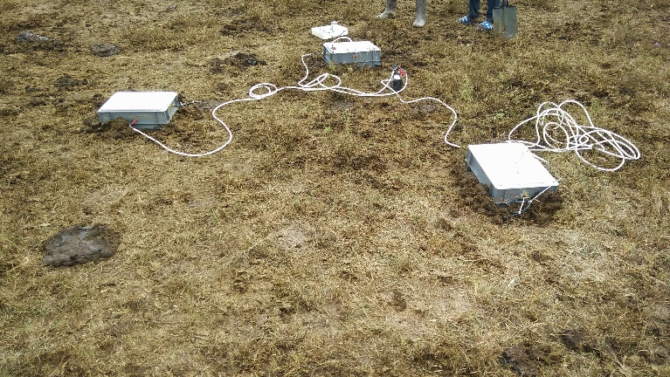
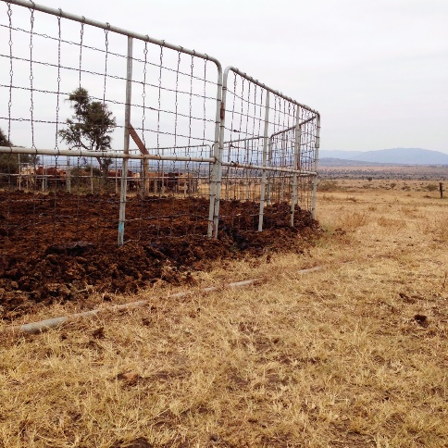
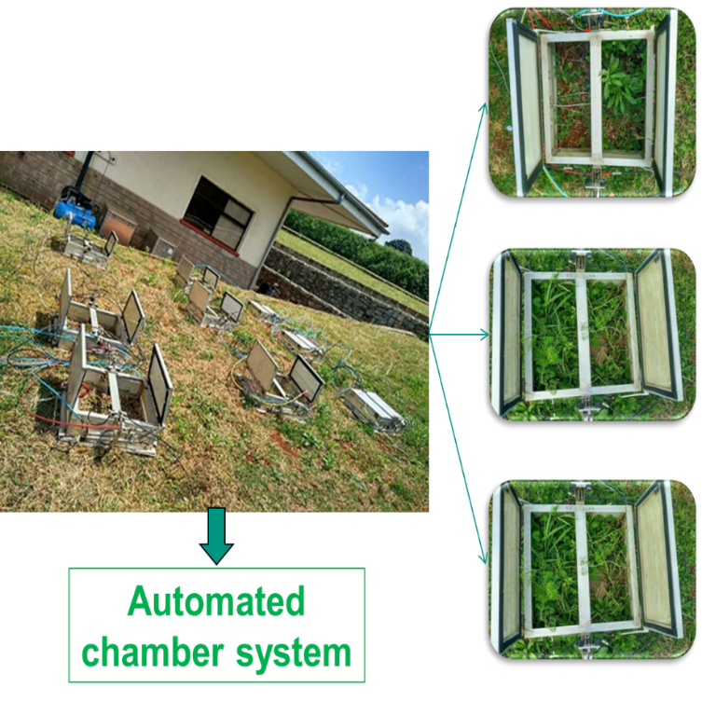
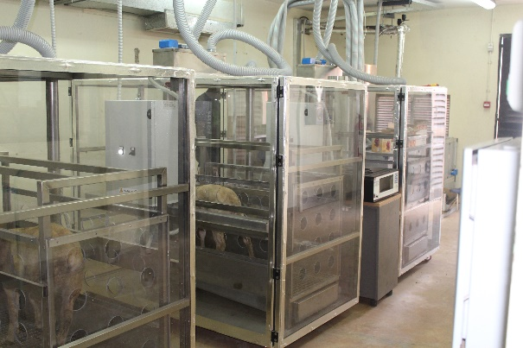
Preliminary results/outputs 3/5
3. Improvement of GHG emission factors
Work done at Mazingira Centre (ILRI)
~ 2/3 of AFOLU emissions related to livestock
Combined use of in situ measurements at multiple scales and calculated emission factors to provide accurate GHG emission baselines from crop-livestock farming
Develop evidence-based intervention strategies
to increase productivity
to lower GHG emission intensities (i.e. yield-scaled emissions)
→ to enhance climate change adaptation
Ndung’u et al. https://doi.org/10.1071/AN17809
Zhu et al. https://doi.org/10.1029/2018GB005949
… and many more under mazingira.ilri.org

Slide 9
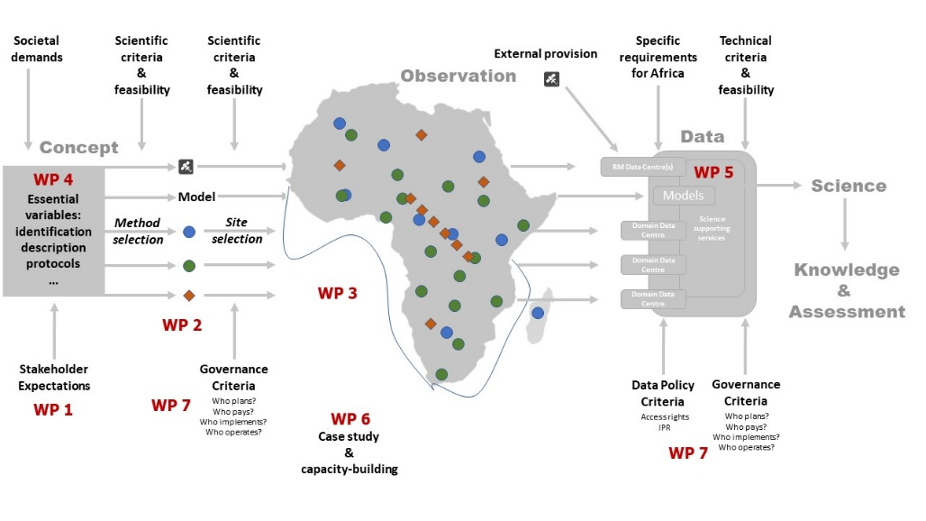
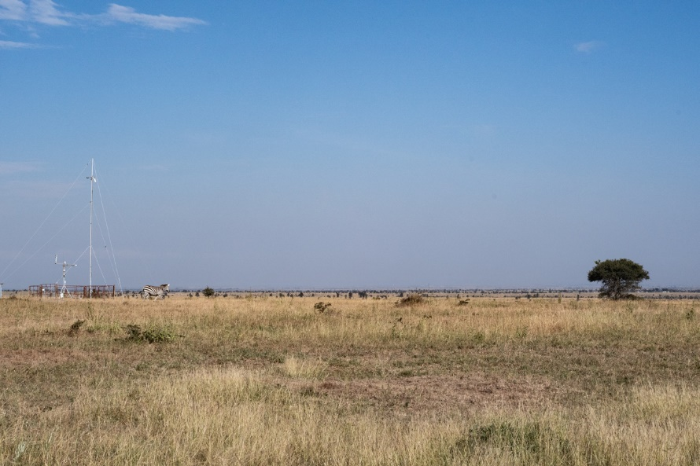

Preliminary results/outputs 4/5
4. Sustainability
Long-term political support and co-financing concept
For initial construction as well as for operation
For both observation and data infrastructures
Key components required for an Africa-wide system
  remotely-sensed products
  model assimilated meteorological products
  atmospheric composition measurement stations
  ecosystem flux monitoring stations
  automated weather stations
  campaign-based calibration products
  for agricultural and land-use factors
  national GHG inventories

Slide 10
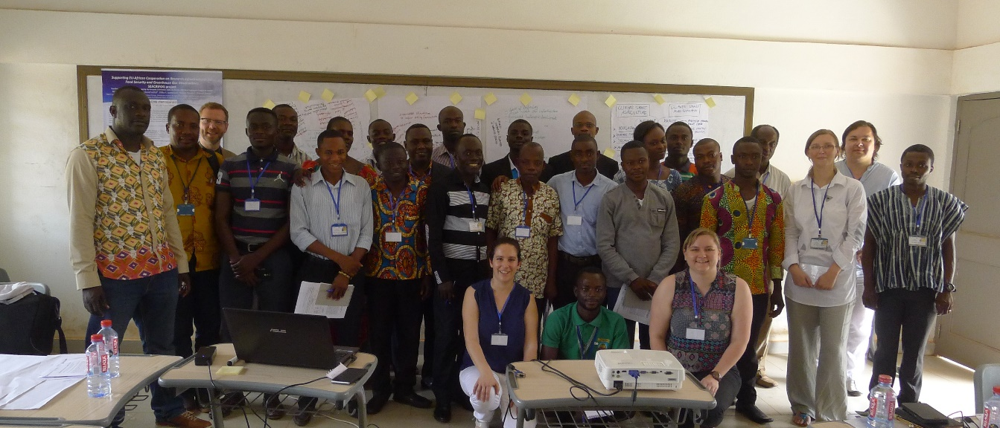
Preliminary results/outputs 5/5
5. Costing exercise for different groups
  Initial cost for new sites: equipment, including installation and maintenance.
  Operation cost considered for ecosystem flux measurement, atmospheric measurement sites…
  Cost of processing, storage and serving data for remotely-sensed products, automated weather stations and meteorological products
  Travel, subsistence and human capacity cost for campaigns and site-based observations
  Capacity-building cost
  Eventually decommissioning cost.

Slide 11
Towards a sustainable system
SEACRIFOG Dialogue Platform (SDP)
  Meeting planned early 2020
  Venue (in Africa) and date tbc
Presentation of developments in technical
and scientific feasibility
Design concept, funding and partnerships
for sustainability
Policy advocacy: Knowledge for evidence-based decision-making, impacting governing bodies at global and grassroot levels
Long-term commitment strategies for SDP
Confirmed interest of stakeholders for the SDP
EU-AU HLD on STI
African Academy of Sciences
International Development Research Centre
RCMRD
African Risk Capacity
WMO African Regional Climate Center
AfriGEO…

Slide 12
Expected Application Areas of Products & Services
GHG Inventories
  Reduced uncertainty
Energy
  Partnerships with national energy associations (measures for energy efficiency e.g. through carbon tax)
Health
  Partnerships in health research
  (e.g. on the impact of global warming
  on disease epidemiological dynamics)
Food security and nutrition
  Livestock rearing and cropland use to lower GHG emissions, esp. methane
and hopefully many more!

Slide 13
Further questions and remarks? mylene.ndisi@icos-ri.eu www.seacrifog.eu @SEACRIFOG
Thank you!

